Slide 1
GenAI Email Classifier with OCR
Team Name: Elite Eagles
Date: March 27, 2025

Slide 2
Problem Statement
Consumer Bank lending service receives a significant volume of servicing requests through emails. These emails contains diverse requests with attachments and will be ingested in to loan servicing platform and create a service requests . Currently creating these services requests ia manual processing and time consuming , error prone and Costly
Develop a Gen-AI powered email classification and OCR solution than can actually extract, interpret the context and categorize the emails in to predefined request types and sub-request types
Delays in processing impact customer service and operational efficiency.
Difficulty in extracting key information for service requests and analysis.

Slide 3
Our Solution
An AI-powered system to automatically, extract data from different email formats , classify them and generate service intake requests from emails and documents and routes the generated service requests to the appropriate teams and individuals based on the skills and roles.
Reduces manual effort, improves accuracy, and accelerates processing.
Provides structured data for analysis and reporting.
Enhances compliance and auditability.
Key Features
Multi-Format Support: Handles .eml, .pdf, and .docx files.
OCR Integration: Extracts text from image-based PDFs and embedded images using pytesseract.
Key Attributes Extraction: Extracts relevant data using AI.
Intelligent AI Classification: Uses Google Gemini API to identify request types and sub-request types classification.
Confidence Scoring: Provides a confidence level for classification.
Service Intake Generation: Creates structured service requests in JSON format.
Priority Assignment: Automatically sets priority based on urgency.
Team Routing: Assigns requests to appropriate teams.
User-Friendly UI: Modern Flask-based web interface with responsive design.

Slide 4
Technology Stack
Backend:
Python 3.12.6+
Flask (web server)
Google Gemini Generative AI
Text Extraction:
pdfminer.six (PDF text extraction)
python-docx (DOCX text extraction)
OCR:
pytesseract (OCR engine)
pdf2image & Pillow (image processing)
Frontend:
HTML, CSS, ReactJS
External Tools:
Tesseract OCR
Poppler (for PDF-to-image conversion)

Slide 5
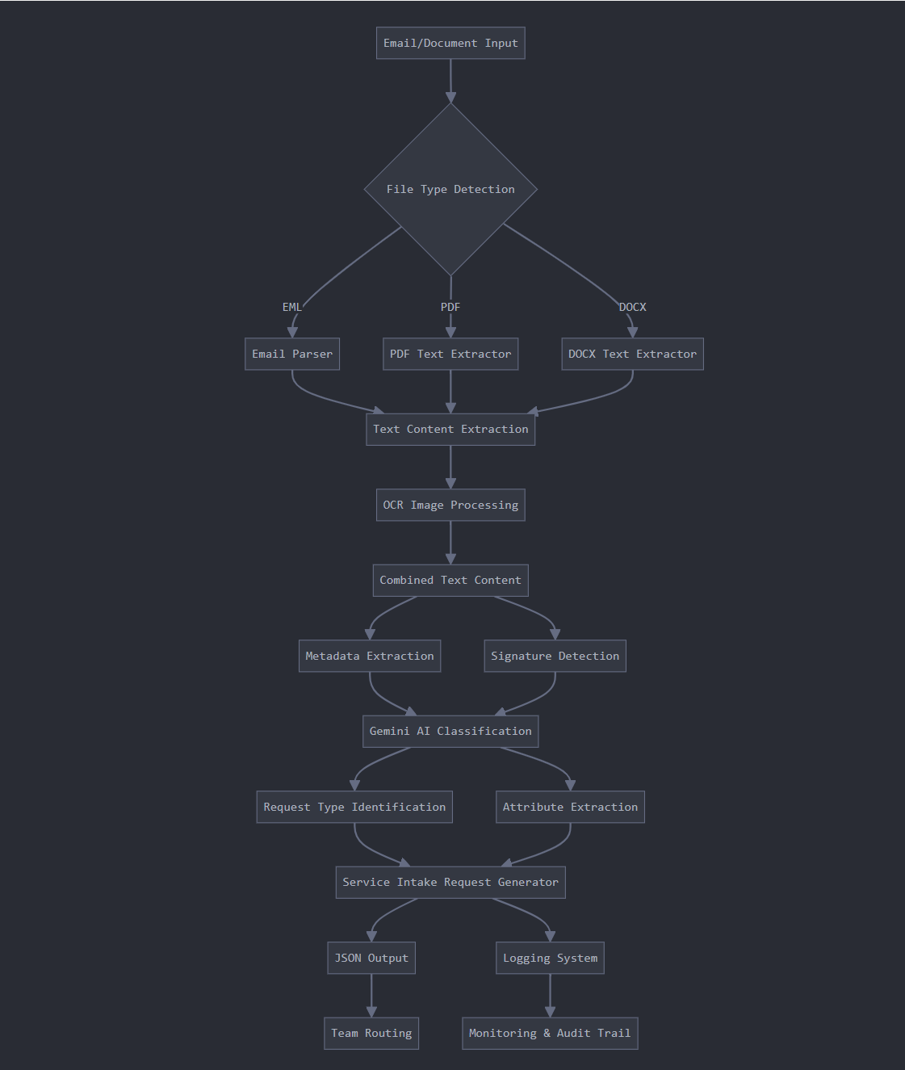
Flow Diagram

Slide 6
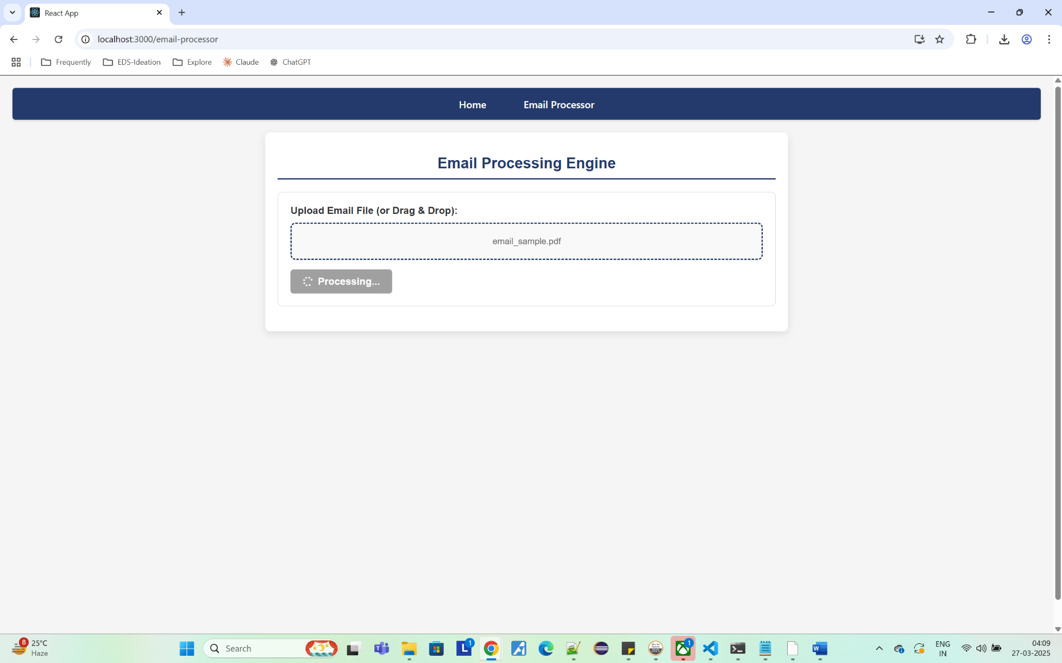
Screenshots

Slide 7
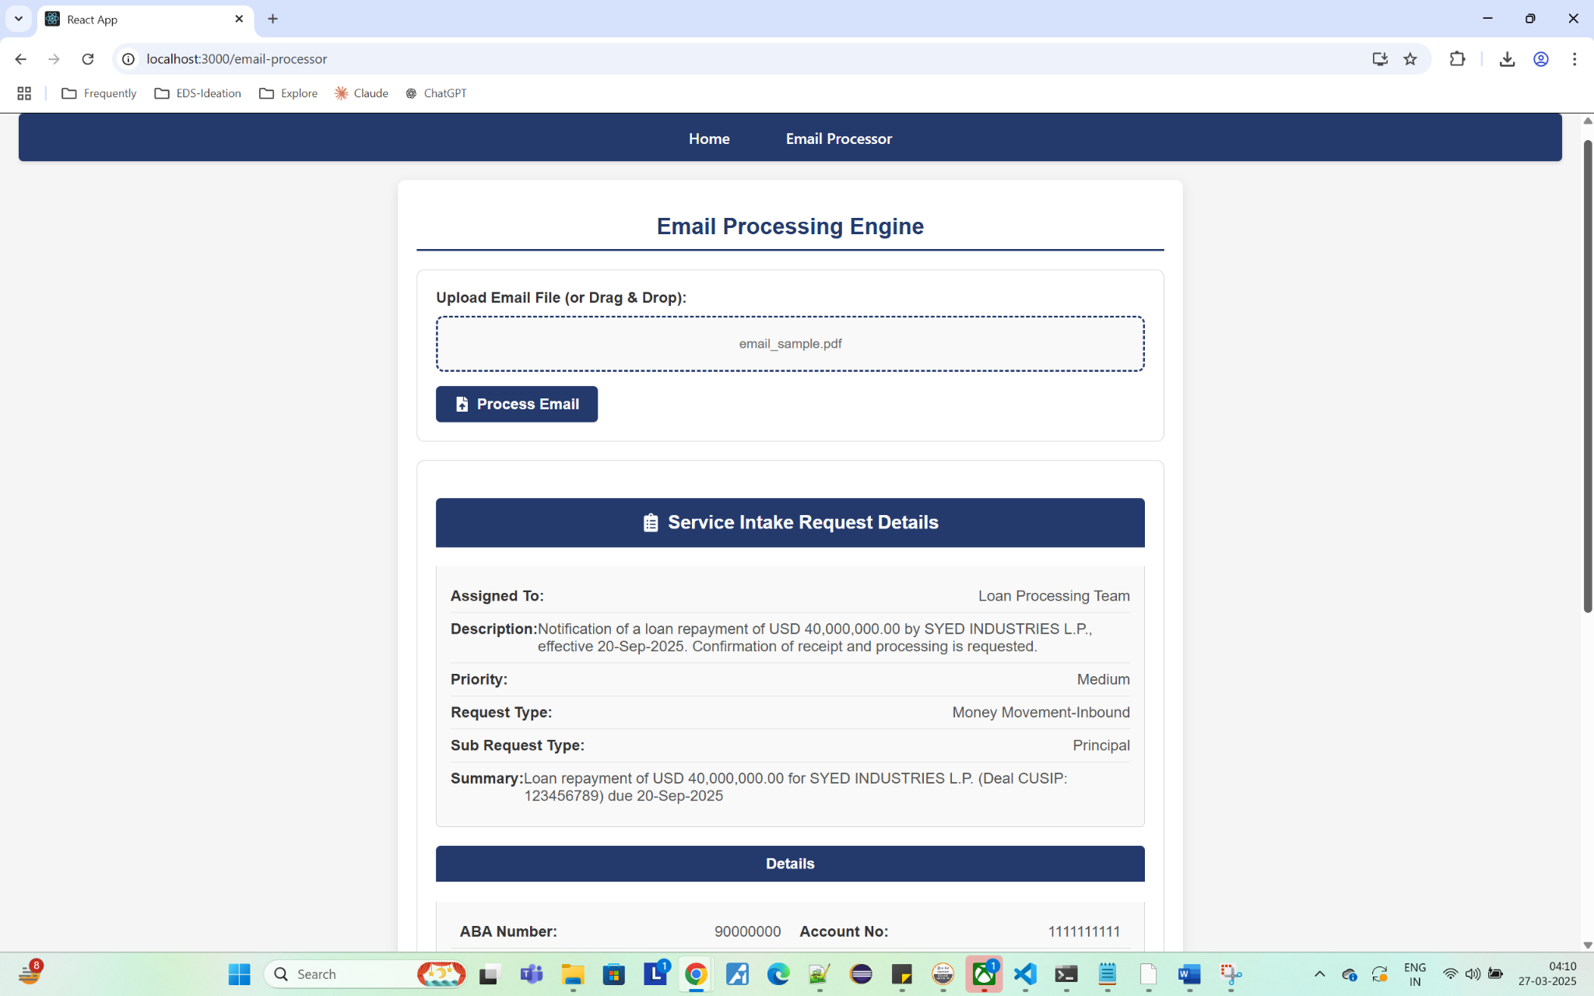

Slide 8
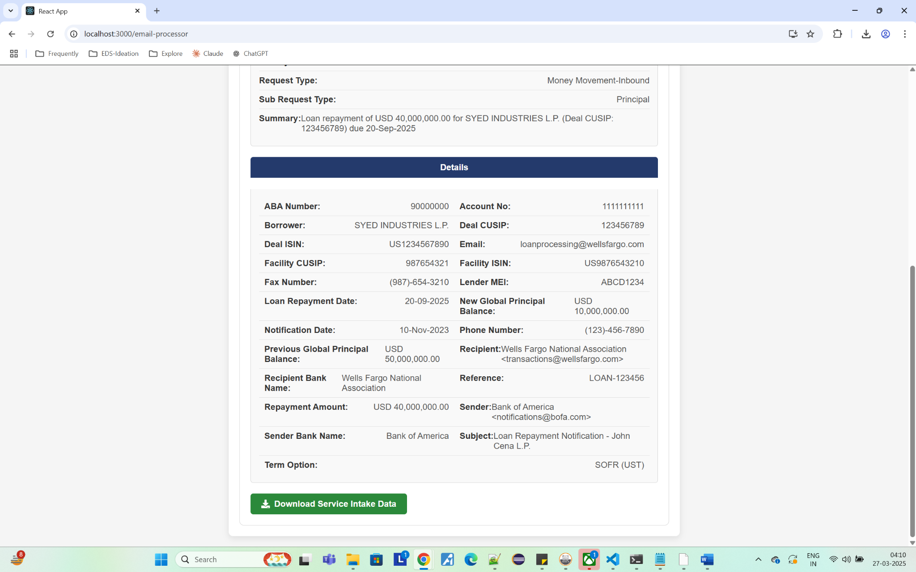

Slide 9
Future Enhancements:
Add support for more file formats
Integrate with email servers for real-time processing.
Integration with existing service request management systems.
Add user authentication and role-based access in the UI.
Deploy to a cloud platform (e.g., OCP, Azure) for scalability.

